Slide 1



Golden Hits Cyprus
Industrial Consulting Project (QHO635)
Module Leader: Nicholas Ioannides
Supervisor: Chathurika Goonawardane

Slide 2

Project Coordinator | Silviu Macarie
Team Member | Alexandru Vlad
Team Member | Hristo Panayotov
Team Member | Laurentiu Cornateanu
Team Member | Maria Moraru
Team Member | Adelina Bucataru
Team Member | Dan Gherasimciuc
About us:
BSc (Hons) Computing (BCOMQ)
https://internet-radio.projectsportal.uk/.

Slide 3
Background & Context
A new start-up company is being established in Cyprus with the intent of radio broadcasting through the internet.
Non-contemporary music from 1960s to the 2000s.
.
The business requires a web platform with a robust backend that enables communications with listeners and fans.

Slide 4

Introduction
Radio became a tool for social cohesion because of its exceptional reach since it allowed people from many socioeconomic groups and backgrounds to come together and experience the world as a whole.
Consequently, combining radiophonic content with visual elements like text, pictures, and videos is far more common. Radio online currently includes content fragmentation, on-demand radiophonic content archives, and online radio on smartphones and websites. Likewise, radio listeners now have greater access to radio material than they did in the past, thanks to various mobile devices.

Slide 5












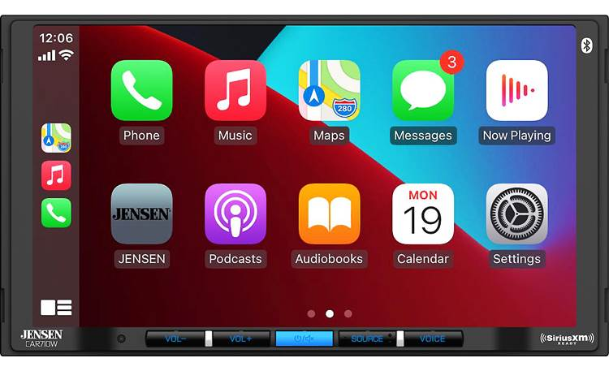

Devices Well-established value chain in the Cyprus online radio market
East cost radio cyprus
Radio
marketers
Special marketers
for online radio
Online-Only
broadcast
stations
Personalised
services
Online radio aggregators
▪ Webradio Networks
Streaming Provider
Internet Service
Provide
Smartphone
Online radio
receiver
Computer

Slide 6



Problem faced by online radios
No one is paying for internet radio
Lack of a strong brand
Royalties for online streaming
Android Auto and Apple Car Play Cracking the in-car listenership
Generating listenership
Mastering social media & other promotional tactics

Slide 7



Analysis of the market
The music streaming market was headed by the audio streaming category. In recent years, listening patterns have shifted steadily to internet platforms. Preference for smart devices, smartphones, and tablets continues to expand, which will have a significant impact on the audio streaming market throughout the projection period.
As audio streaming is available from everywhere, at any time, by anybody.
Consequently, the usage of Spotify, Amazon Prime, and YouTube for music is growing. Moreover, Labels as a Service (LaaS) is becoming one of the most prominent trends in audio streaming and is anticipated to provide additional development prospects for the audio streaming industry.
.

Slide 8
This statistic was automatically created using the well-proven Statista forecast algorithm based on similarity parameters to existing analyst forecasts. The basis for the original forecasts is a combination of time series forecasts, driver forecasts (GDP, population etc.) from sources such as World Bank or the International Monetary Fund and business surveys.

Slide 9
As digital music streaming services and websites alter the musical landscape, music streaming is gaining popularity worldwide. In the music streaming industry, the introduction of cloud-based music is increasing, which in turn encourages the adoption of music platforms. All of these elements contribute to the expansion of the music streaming sector

Slide 10
Advantages over the classic radio
Traditional radio station broadcasts are limited by two factors:
1. The power of the station’s transmitter (typically 100miles)
2. The available broadcast spectrum (you might get a couple of dozen radio stations locally)
Internet radio has no geographic limitations. The potential for Internet radio is as vast as cyberspace itself.
Internet radio is not limited to audio. An Internet radio broadcast can be accompanied by photos or
graphics, text and links, as well as interactivity, such as message boards and chat rooms. This advancement
allows a listener to do more than listen. The cost of getting “on the air” is less for an Internet broadcaster. Internet radio can appeal to “micro-communities” of listeners focused on special music or interests.z

Slide 11
Difference from the classic radio
Additionally, podcasting, which requires downloading rather than streaming, differs from internet radio.
A lot of traditional (terrestrial) radio stations have related Internet radio services.
Online radio stations may typically be accessed from any location in the world; for instance, listeners in Europe can access an Australian station.
Due to worries about music licencing and advertising, some large networks prohibit listening in the country.
Online radio is an audio service that is broadcast via the Internet. It is also known as web radio, net radio, streaming radio, and e-radio webcasting.
Similar to traditional broadcast media, internet radio involves streaming material that provides listeners with a never-ending stream of audio that can't be paused or replayed; in this regard, it differs from on-demand files providing

Slide 12
How it functions
Through a sound card, the audio enters the computer used for encoding by the Internet broadcaster.
The encoder system converts the sound card's audio into a streaming format.
In order to send the data over the Internet, encoder samples the incoming audio and compresses it.
The server, which has a high bandwidth connection to the Internet, receives the compressed audio.
The player software or plug-in on the computer of the listener receives the audio data stream from the server over the Internet.
The plug-in converts the audio data stream coming from the server into the sound the listener hears.

Slide 13
Fulfilled Project Requirements and Objectives
Requirements:
User-friendly design
Incorporate plugins and widgets
Create a secure “Contact” page
Allow users to request songs and post dedications
Enable monetization throught adverts, promotions, etc.
Include analytics and produce frequent analysis reports.
Objectives:
Have an online presence
Monetization
Promote the local culture

Slide 14

Project Deliverables
High-definition Wireframes
Use cases
Mindmap
Storyboarding
User-friendly Front-end
Secure and robust Back-end

Slide 15
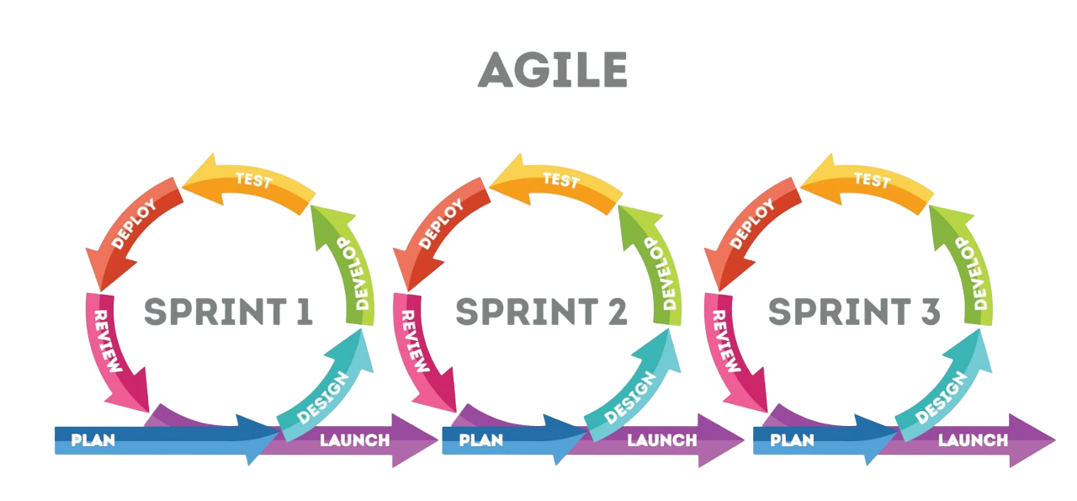
Project Management
Flexibility
Fast Delivery Times
Continuous Adaptation
Prioritisation of Colaboration
Efficient Communication
Steady Pace

Slide 16
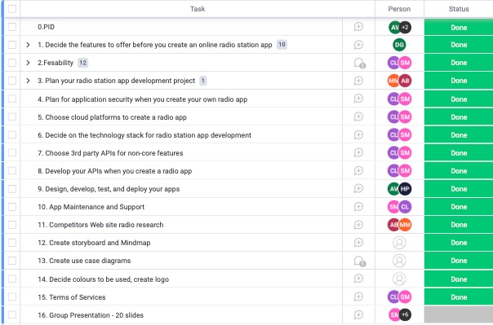
Project Organisation Structure
Monday.com
Task Prioritisation
Simplifies Decision Making
Close Cooperation

Slide 17
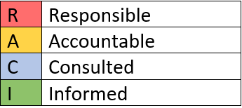
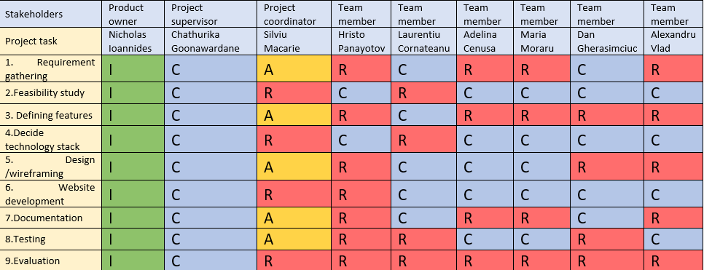
RACI Matrix

Slide 18
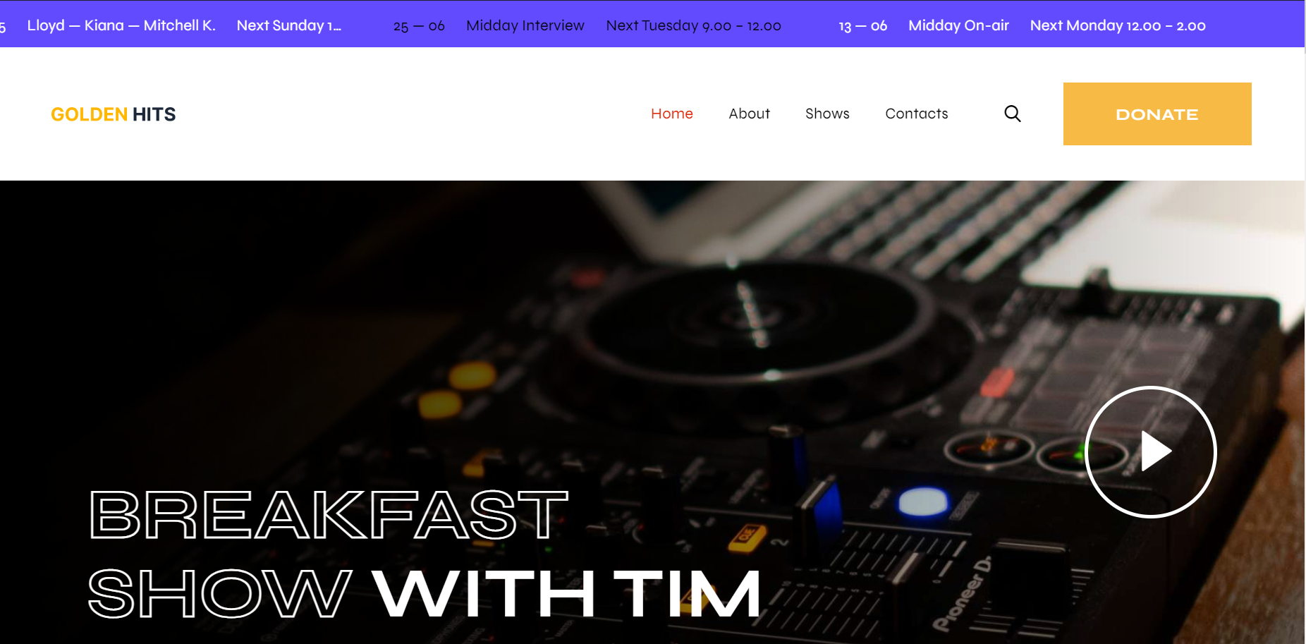
Design and Implementation

Slide 19





Radio Websites Research
Microphone to the citizen where citizens report problems and they are discussed live on radio or live chat
How they monetize their websites
Events
Competitions

Slide 20
Testing and Recommendations for Future Improvements
Usability testing
Performance Testing
Mobile Website Compatibility Test
Cross-Browser Compatibility Testing
Accessibility Testing
Boost the bandwidth
AWS cloud hosting
Mobile Application
Multi language support
Search engine optimization

Slide 21

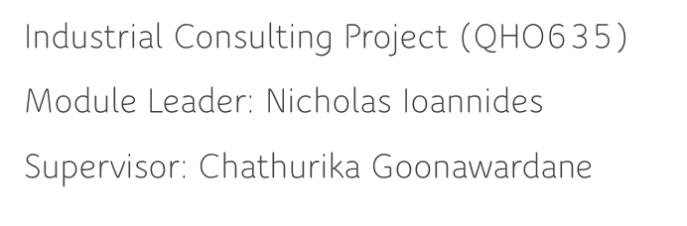
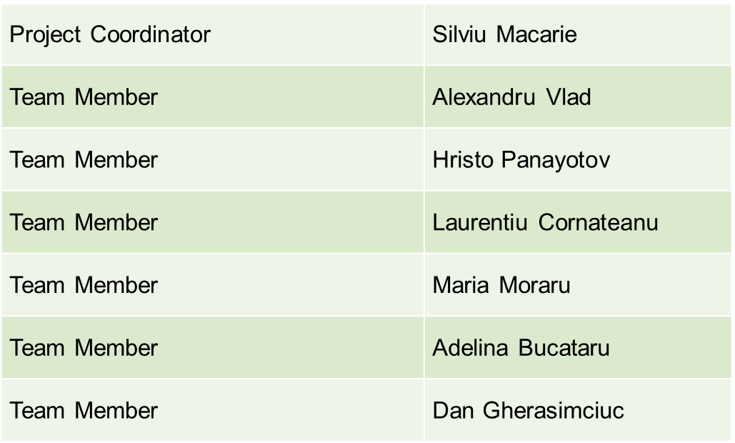
Thank you!

